Slide 1
Data Collection & Descriptive Analysis
Harrison Cradduck, Marah Donahoe, Joey Endres, William Knapp

Slide 2
Project Overview

Slide 3
Problem Statement
Producers/record labels make money when their signed artists and bands create popular songs, so our goal to help them get a better understanding of what makes a song “popular” or “viral” by building models to predict the success/popularity of a song on YouTube (measured as number of views) through the use of predictors like genre, artist history & type, song audio features, and sentiment analysis of the lyrics and song title.
If we later find a way to pull Spotify popularity metrics (streams), we will build a second set of predictive models to predict streams.
We would then be able to contrast the two sets of models and potentially discern what predictors have the most influence on a song’s popularity on YouTube versus Spotify.

Slide 4
Data Collection

Slide 5
Song Titles & Artists
Purpose: create a unique, large, comprehensive list of songs for data analysis
Pulled song titles, artists, and chart year from the weekly top 100 billboard charts from 1990 to 2025
  Web-scraped from www.billboard.com/charts/hot-100 using Beautiful Soup
Cleaned artist names for searching / merging / joining data
Kept unique combinations of titles and artists
18,959 unique songs

Slide 6
Song Lyrics
Matched song lyrics (text) to songs in the dataset
  Used Lyrics Genius Python library to pull song lyrics from Genius API by title and artist
18,959 requests ~ 5 hours
1,562 songs with missing lyrics, 3,524 duplicate songs
13,873 songs with complete lyrics
Intend to conduct sentiment analysis on lyrics for predictive power
  May explain noise over patterns due to lots of diverse words

Slide 7
Artist Features
Pull artist-related features for unique artists in the dataset
  Used MusicBrainz API and Wikidata SPARQL endpoint to pull data about artists within the songs dataset
Name, type (person, group), genre(s), country, start year of career, etc.
4,322 unique artists
Intend to account for artist history and industry nature in predicting song popularity
  Fine line between predicting song popularity vs. artist popularity

Slide 8
YouTube Metrics
Pulled YouTube video metrics (numeric) for corresponding songs in the dataset
  Attempted to use YouTube Data API v3; met with 100 requests ~ day limit
  Web-scraped / extracted metadata from YouTube videos using yt-dlp Python package, essentially creating a data collection API
17,397 requests ~ 11 hours
15,002 songs with view, like, and comment counts
Unique avenue / platform for popularity metrics
  Some songs don’t have music videos, YouTube metrics, or public information / metadata

Slide 9
Spotify API Features
Pulled Spotify audio features (numeric) for corresponding songs in the dataset
  Attempted to use Spotify Web API; audio features API endpoint deprecated 11/2024
  Downloaded 6 Kaggle datasets with Spotify audio features (created before endpoint deprecation) and merged with matching songs on track ID, then title and artist
Energy, key, acousticness, loudness, liveness, etc.
6,578 songs with Spotify audio features
Incorporates both song facts and listener preference into analysis
  Popular predictors in song analyses, but what/who determines values?

Slide 10
Descriptive Analysis

Slide 11
Dataset
6,578 songs (unique combinations of titles and artists)
Response variable: “view_count”
  Consider weighted combination of “view_count” and “like_count”
42 predictor variables
  Audio features, artist features, lyrics
  29 dummy indicators for “county”, “type”, and “genre” predictors
  13 numeric predictors
All missingness is resolved

Slide 12
Data Preparation
Convert numeric song “key”, artist “type”, and artist “country” to categorical and dummy-code
Perform median imputation on “like” & “view” counts (12 & 26 missing)
  Both variables are right-skewed
Perform zero imputation on “comment” count (127 missing)
  Multiple reasons comments may be missing
Perform mode imputation on artist “type” and collapse levels
  If missing, most likely a person; if not person, most likely a group
Collapse artist “country” into USA, Canada, Great Britain, and Other
  40+ countries with sparse data

Slide 13
Data Preparation
Convert song “chart year” to integer
  Remove trailing decimal placeholder
Correct inaccurate “chart year” (ex. 2029)
Convert artist career “begin_date” to year
  More interpretable, matches chart year
Remove new line indicators from “lyrics”
  Prepare for sentiment analysis
Split list of “genres” into elements and group into major genres (pop, rock, r&b, etc.)
  1700+ unique lists of genres; combine elements into common groups for predictive power and interpretability

Slide 14
Data Summary - Lyrics
Identified basic dataframe summary statistics for pre-cleaned lyrics dataset
  4 variables: title, artist, chart_year, lyrics
  13,873 songs
  12,186 unique titles
  3,634 artists
  36 chart years
Other relevant statistics
  Avg. word count: 429
  Most frequent artist: Taylor Swift
  Most common theme: Love

Slide 15
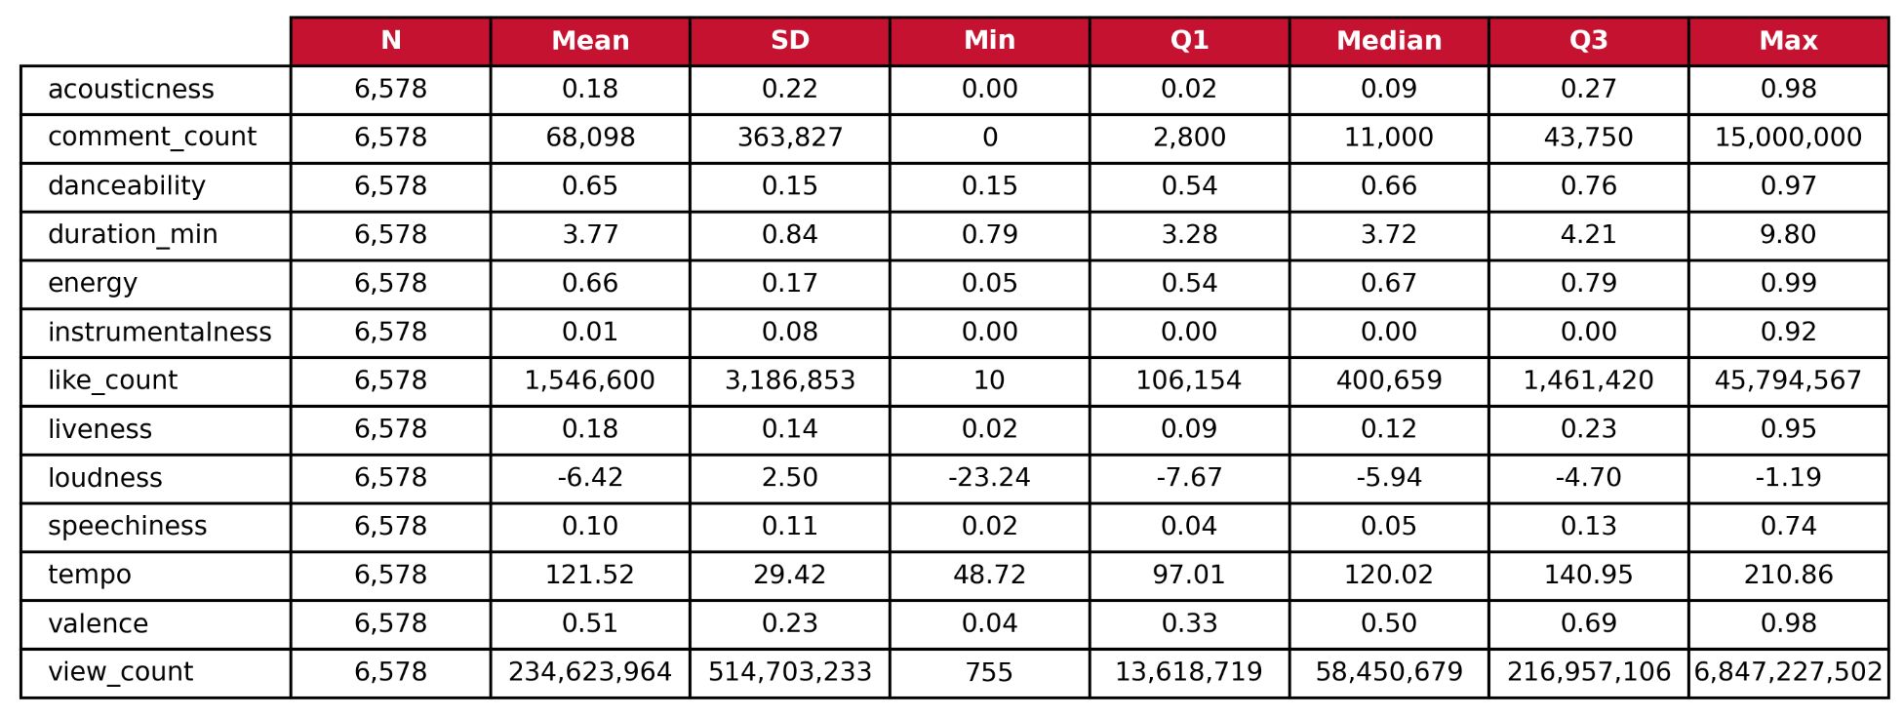
Data Summary - Numeric

Slide 16
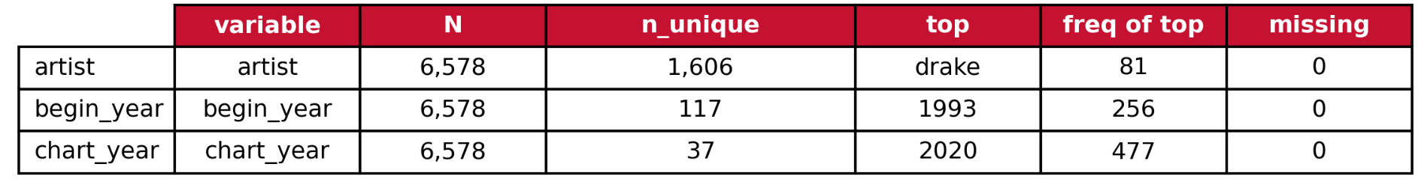
Data Summary - Categorical
Note: title and lyrics are not shown in this table, as there is very little repetition between observations
  For both, N = 6,578 and missing = 0

Slide 17
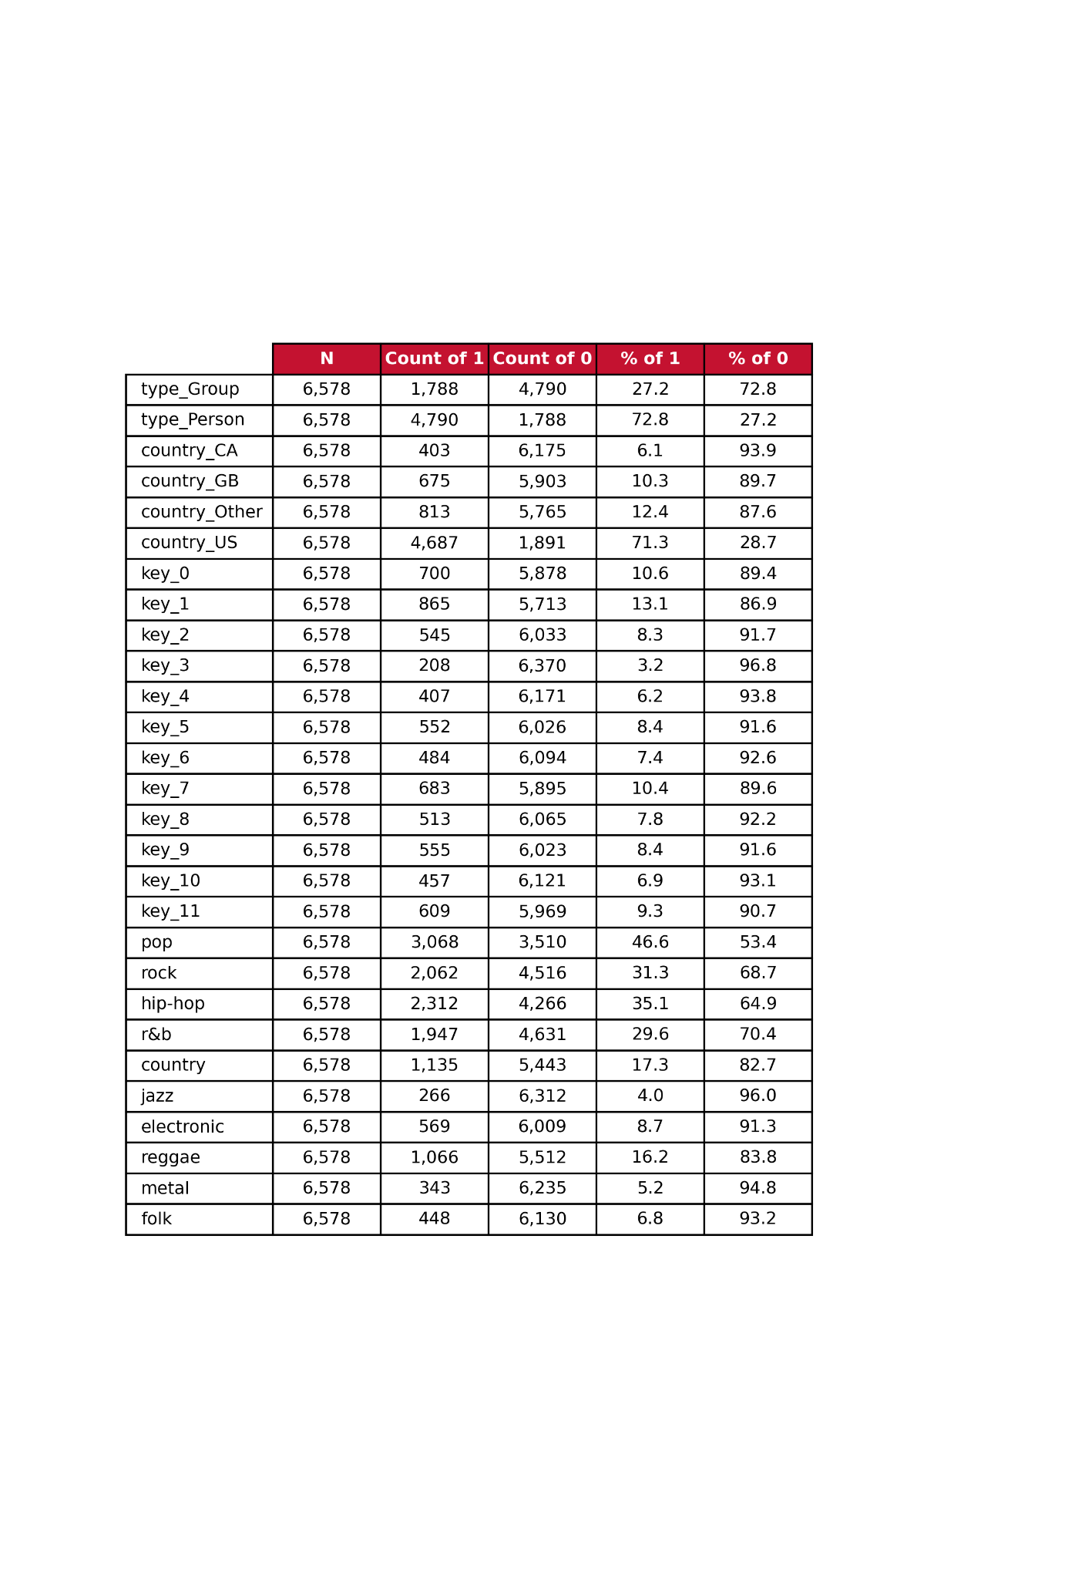
Data Summary - Binary

Slide 18
Data Visualization

Slide 19
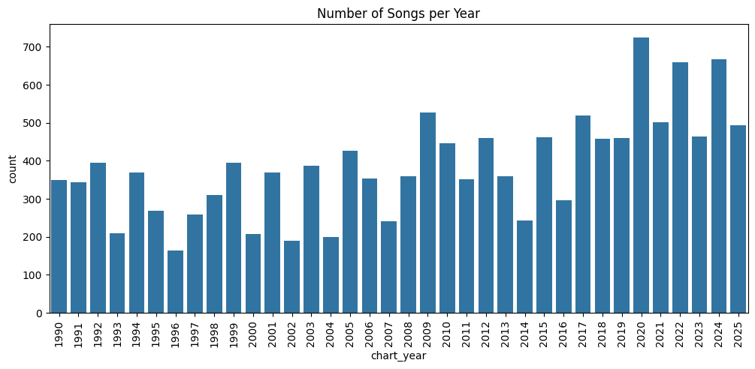
Number of Songs per Year

Slide 20
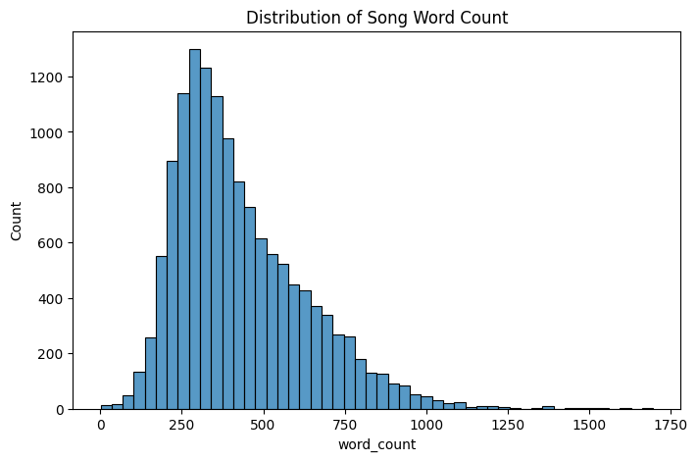
Distribution of Song Word Count

Slide 21
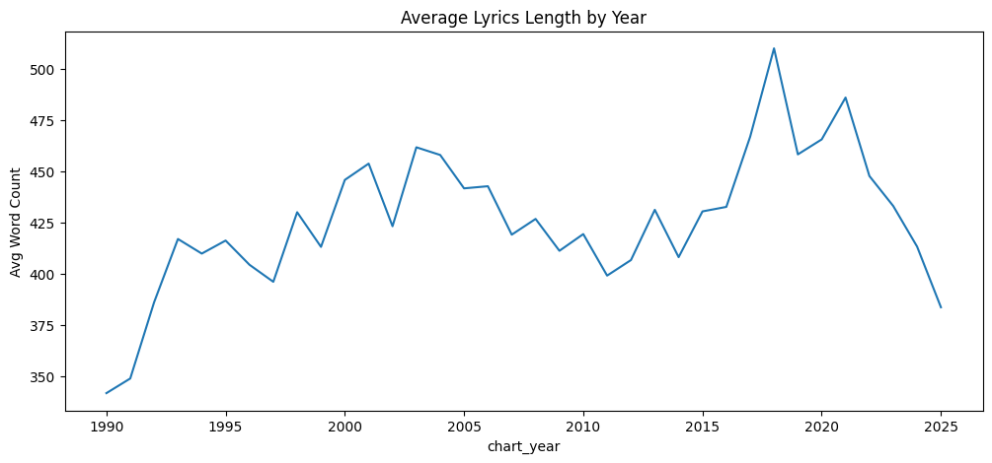
Average Lyrics Length by Year

Slide 22
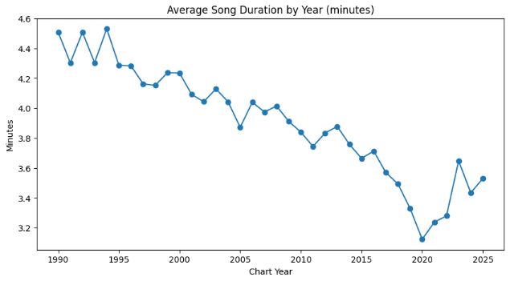
Average Song Duration by Year

Slide 23
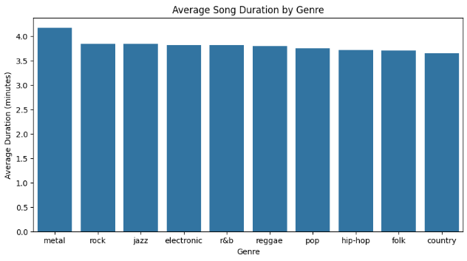
Average Song Duration by Genre

Slide 24
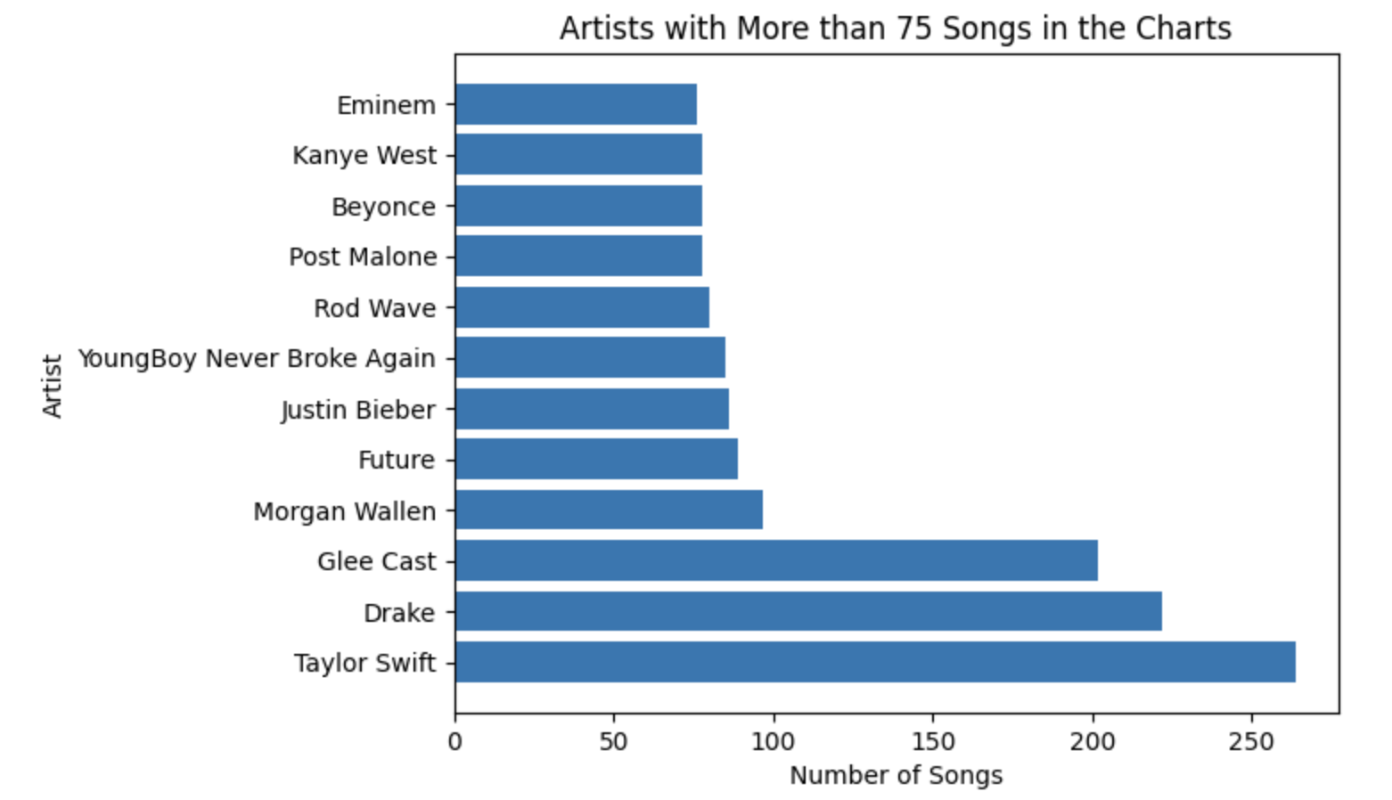
Top Song-producing Artists

Slide 25
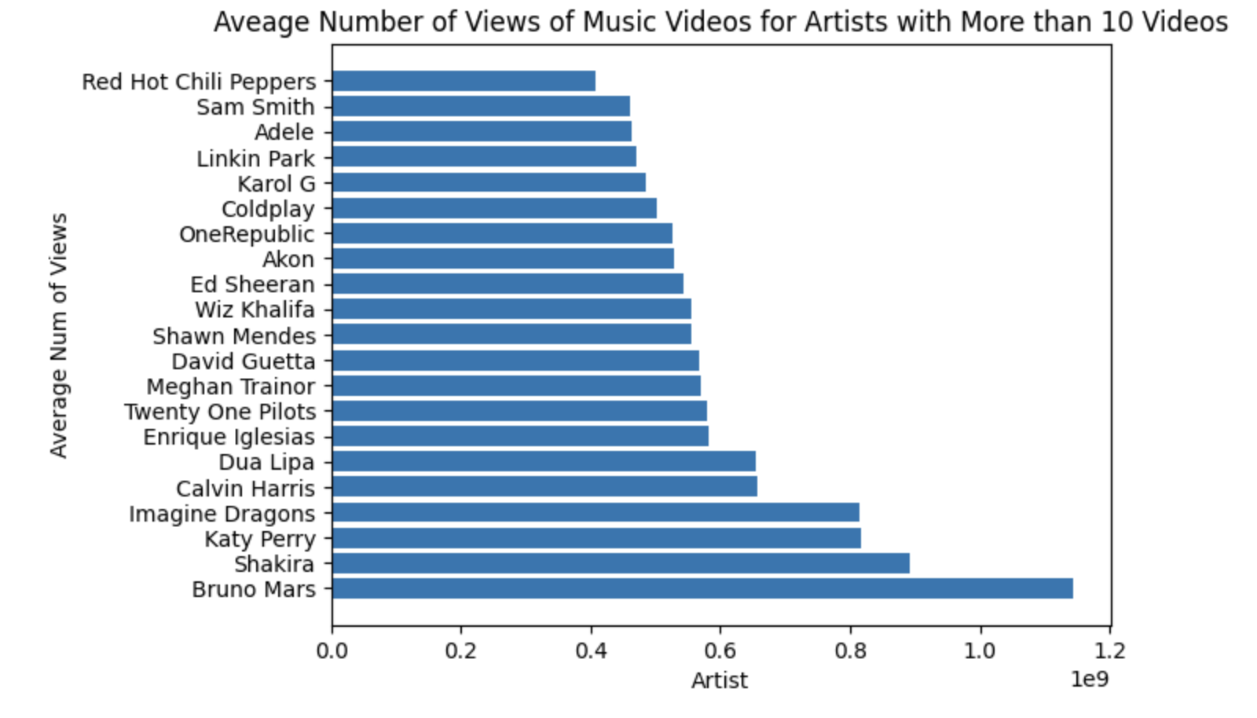
Average Views per Music Video (by Artist)

Slide 26
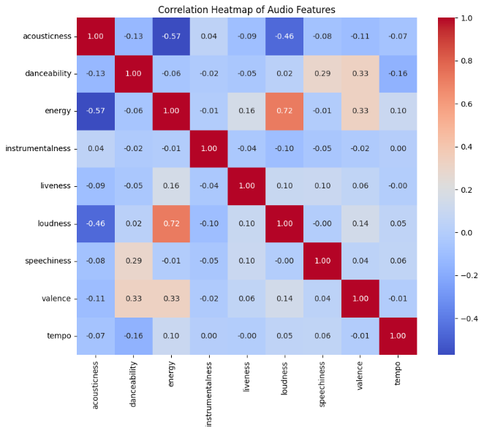
Correlation Heatmap of Audio Features

Slide 27
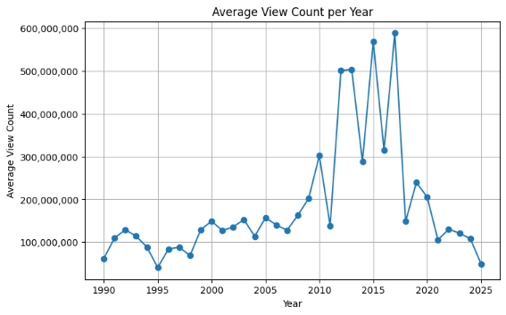
Average YouTube View Count by Year

Slide 28
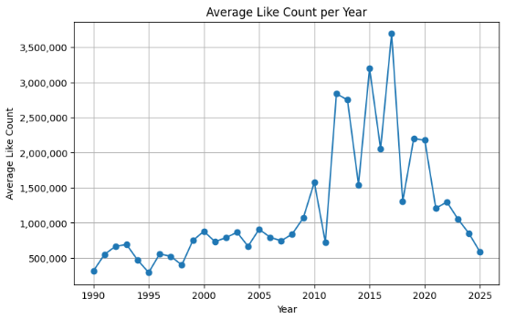
Average YouTube Like Count by Year

Slide 29
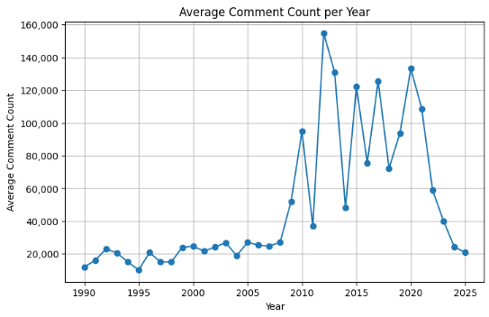
Average YouTube Comment Count by Year

Slide 30
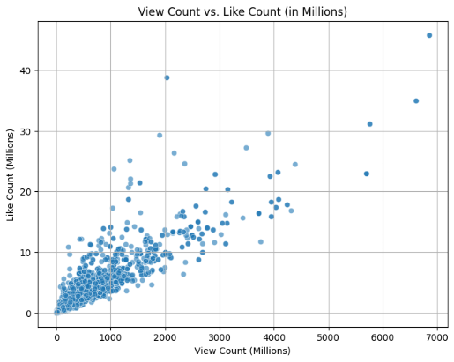
View Count vs. Like Count (Millions)

Slide 31
Next Steps
Feature engineering ideas
  Interaction terms, PCA
  Lyrics and song title sentiment analysis
    Pos, neg, neu, compound
  Topic modeling
Feature selection ideas
  Stepwise selection, regularization, variable importance (RF)
Model building ideas
  Multiple linear regression
  Support vector regression

